Slide 1

Understanding the impact of COVID-19 pandemic and the effect of vaccination in the United States
Ruby Nguyen | Mano Chitra Tom Sanchez | Tracy Poon

Slide 2
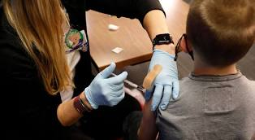
Project overview
COVID-19 pandemic has led to high rates of mortality across the globe. In an effort to minimize the spread of COVID-19, vaccines have been developed at an exceptional pace.
The scope of this project is to understand the impact of COVID-19 vaccines to curtail the pandemic since it is relevant to the current situation.

Slide 3
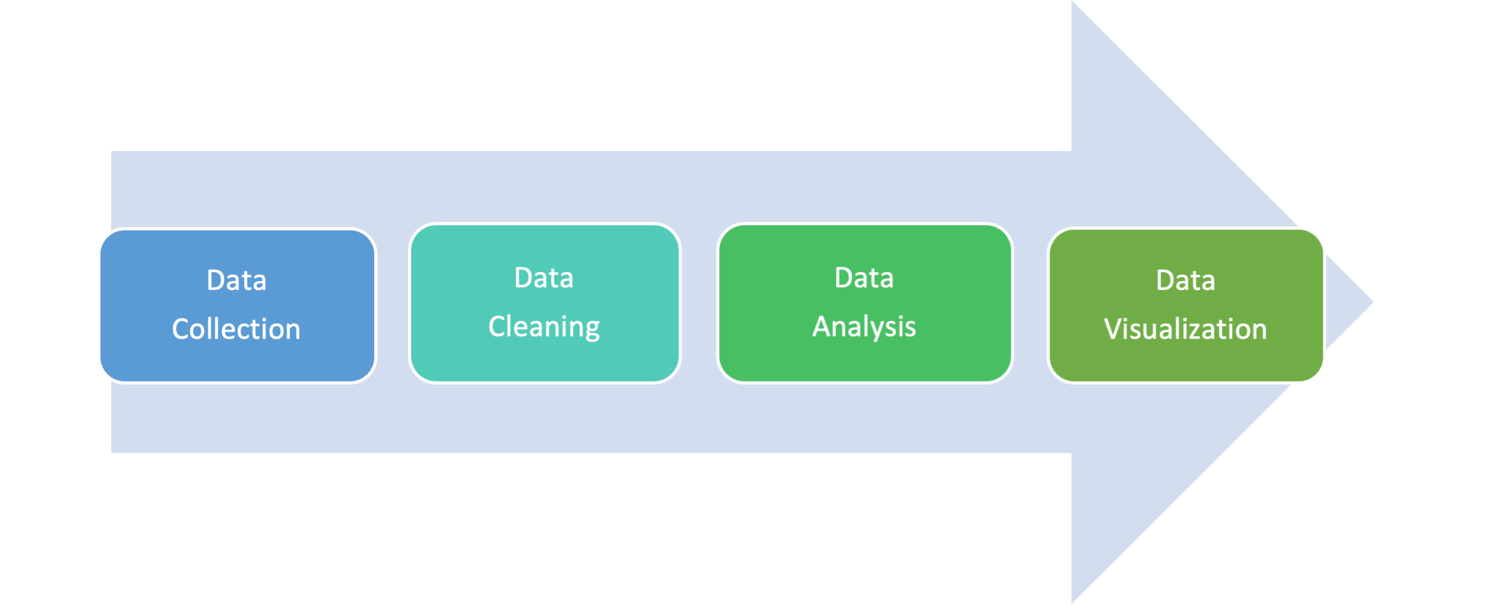
workflow

Slide 4


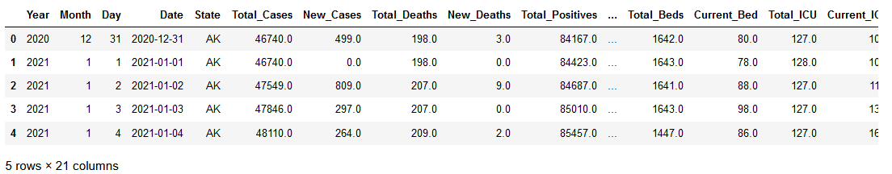
Data collection
Covid Data: https://covidactnow.org/data-api
Census Data: https://www.census.gov/data/developers/data-sets/popest-popproj/popest.html

Slide 5
Research objective #1
State-wide distribution of COVID-19 cases and deaths in 2021 in the United States

Slide 6
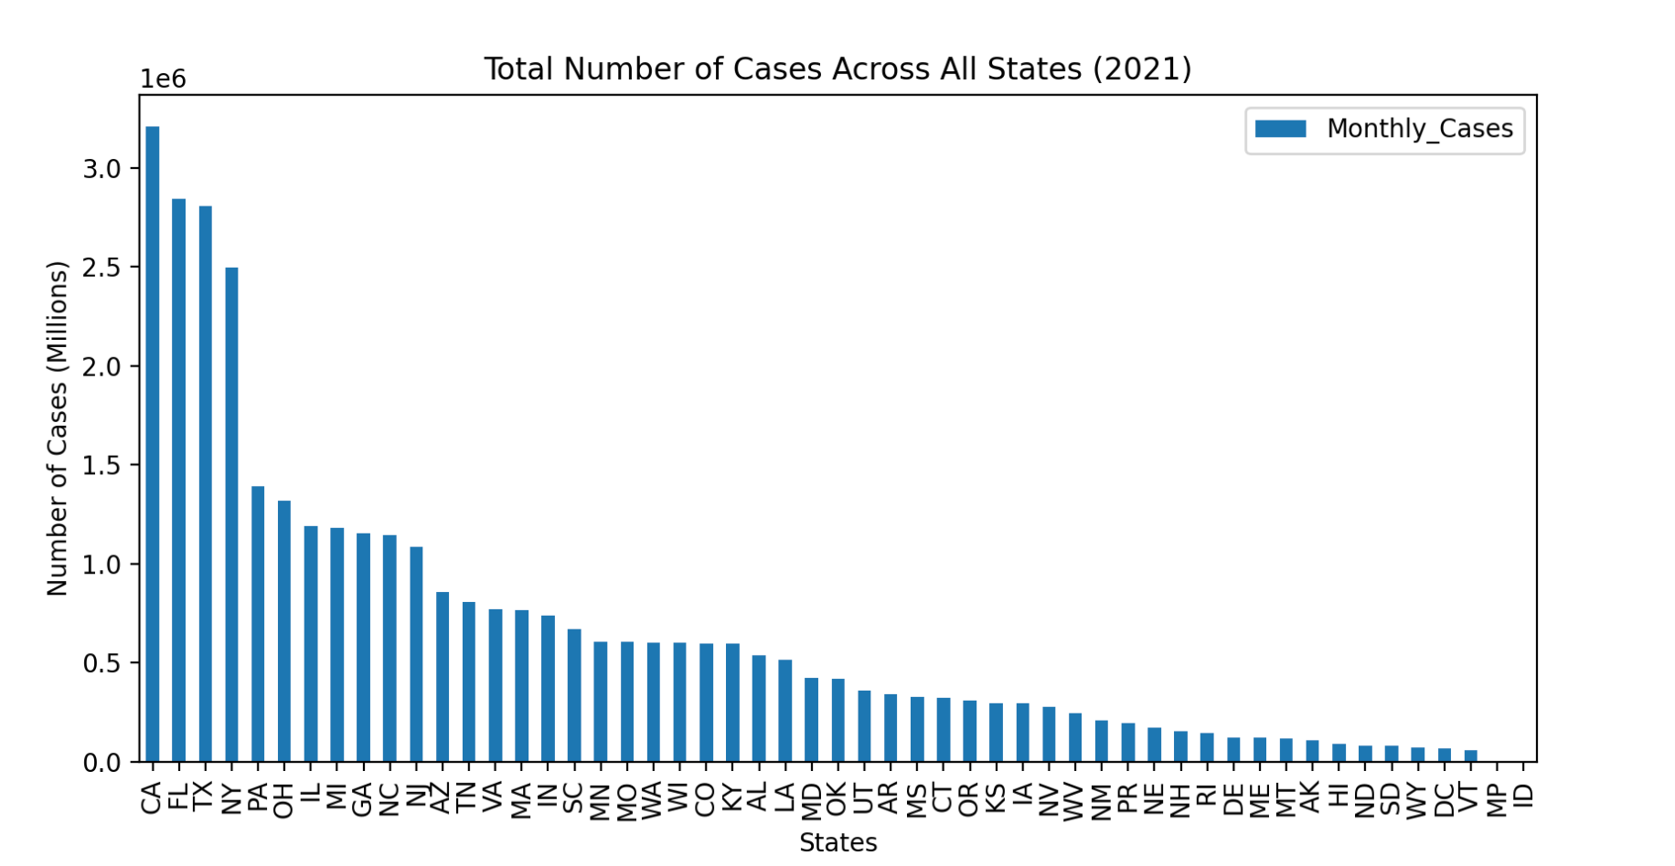

Slide 7
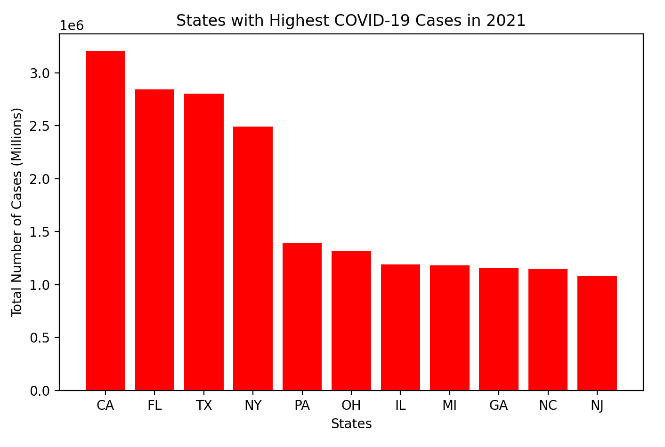

Slide 8
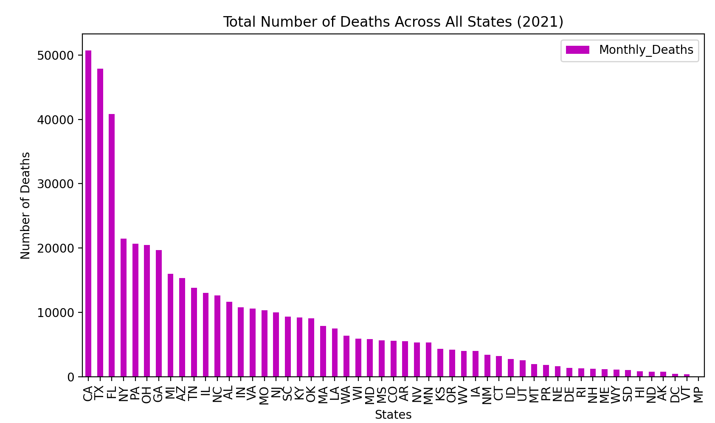

Slide 9
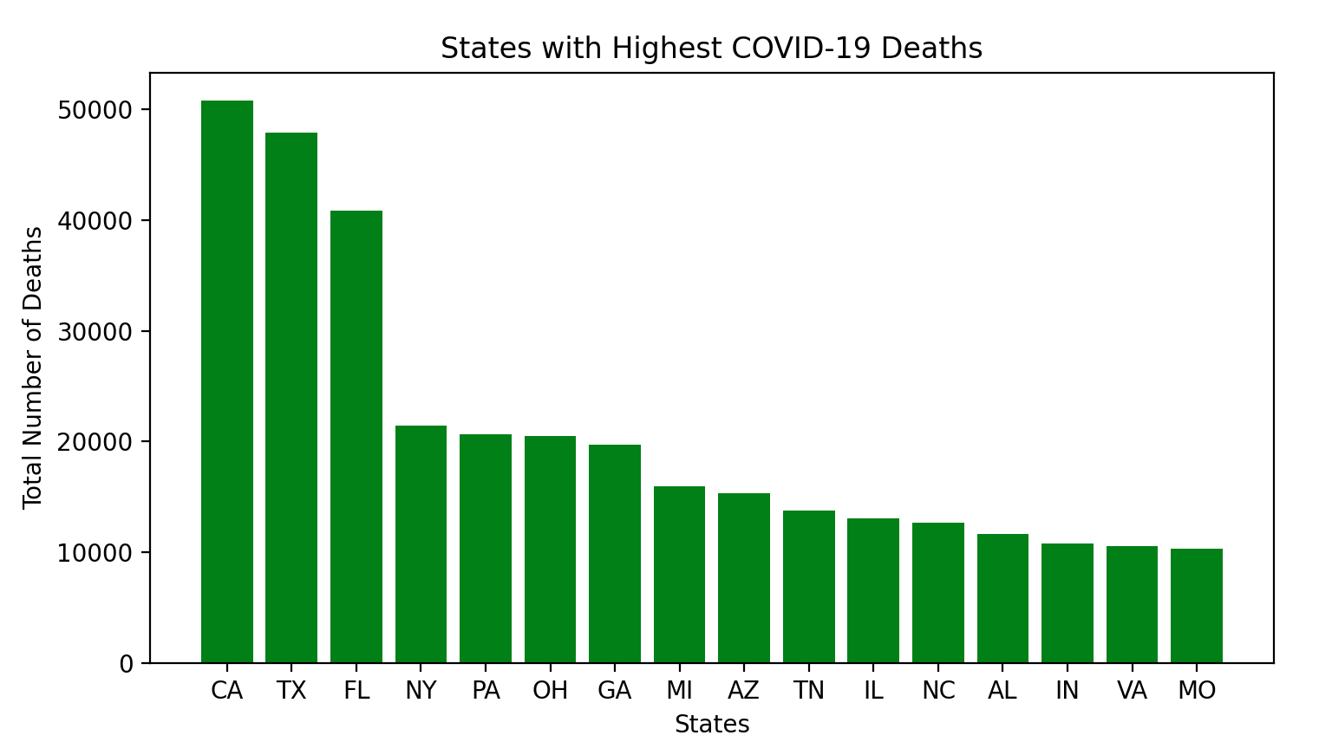

Slide 10
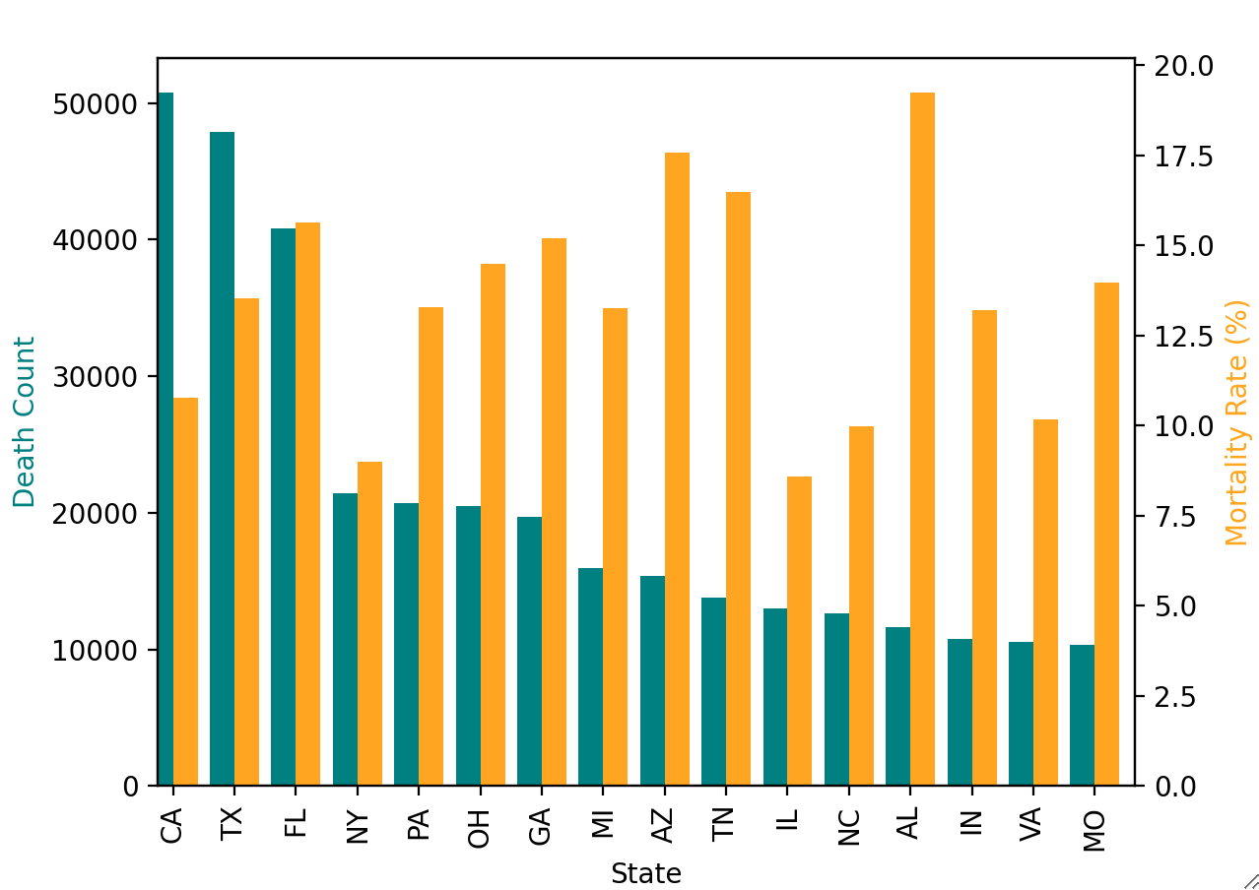
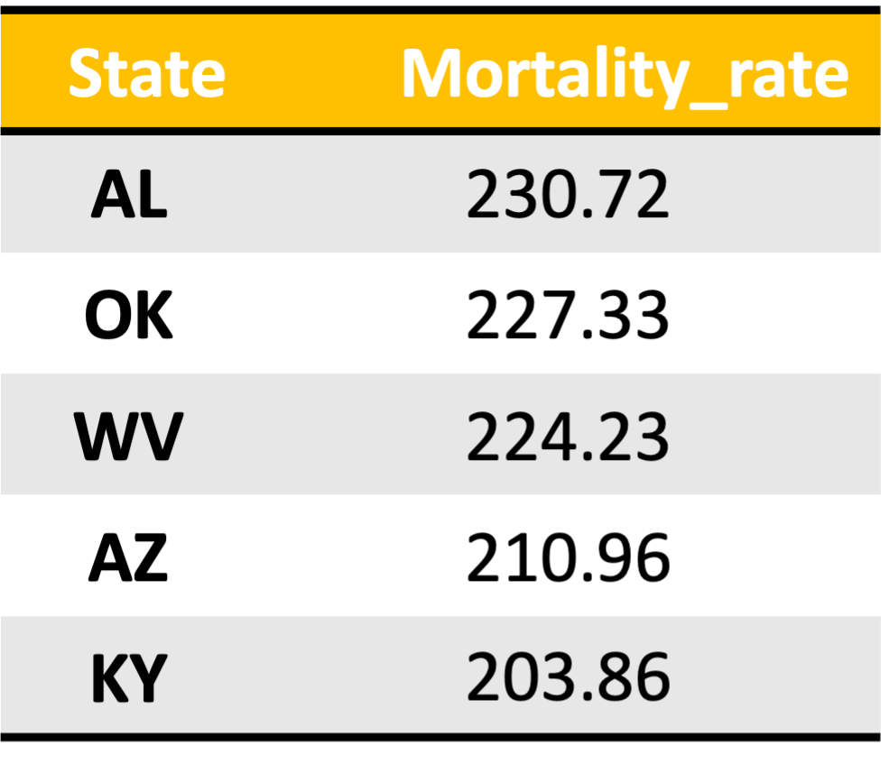
Death Count vs. Mortality Rate

Slide 11
Research objective #2
Monthly pattern of COVID-19 cases and mortality rate in 2021

Slide 12
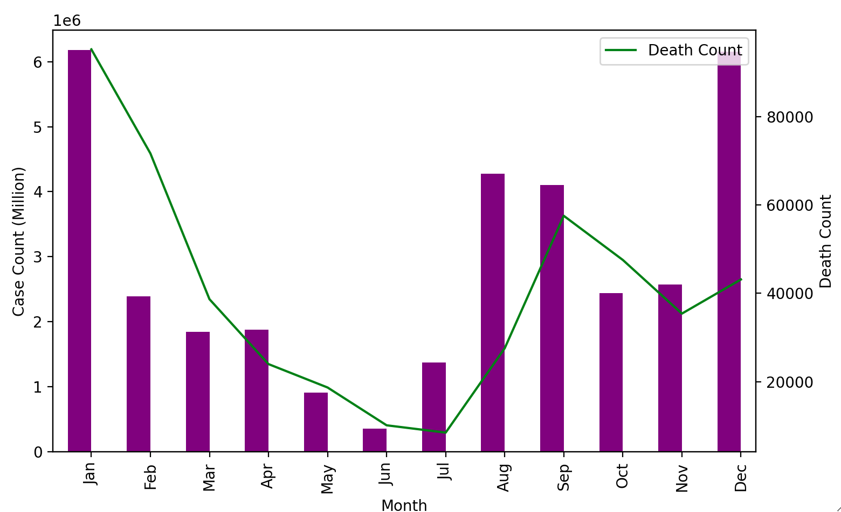
Case Count vs. Death Count

Slide 13
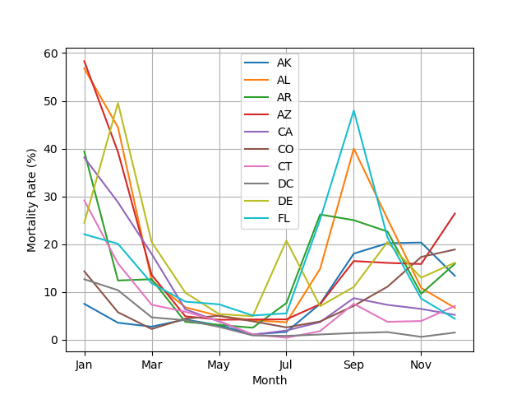
State-wide Mortality Rate

Slide 14
Research objective #3
Trends in vaccination in the United States

Slide 15
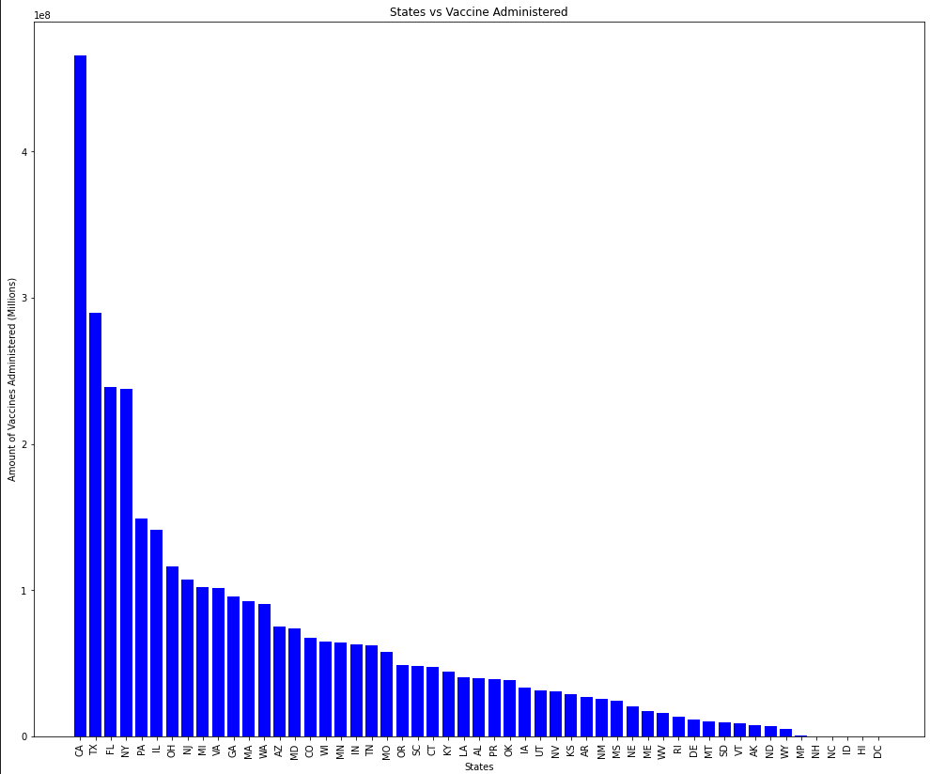

Slide 16
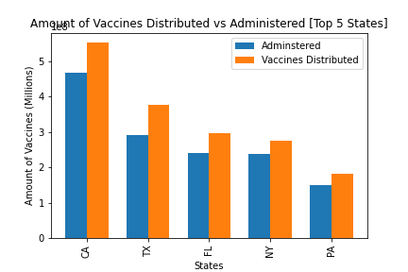

Slide 17
Research objective #4
Impact of vaccination on number of cases, deaths and hospitalization in the United States

Slide 18
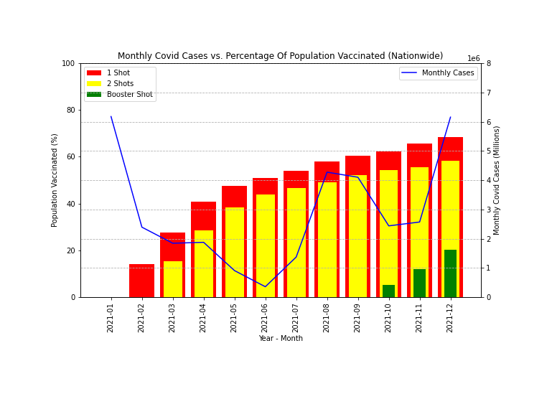

Slide 19
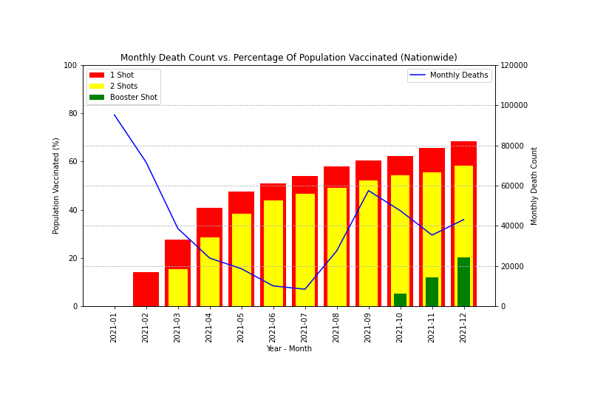

Slide 20
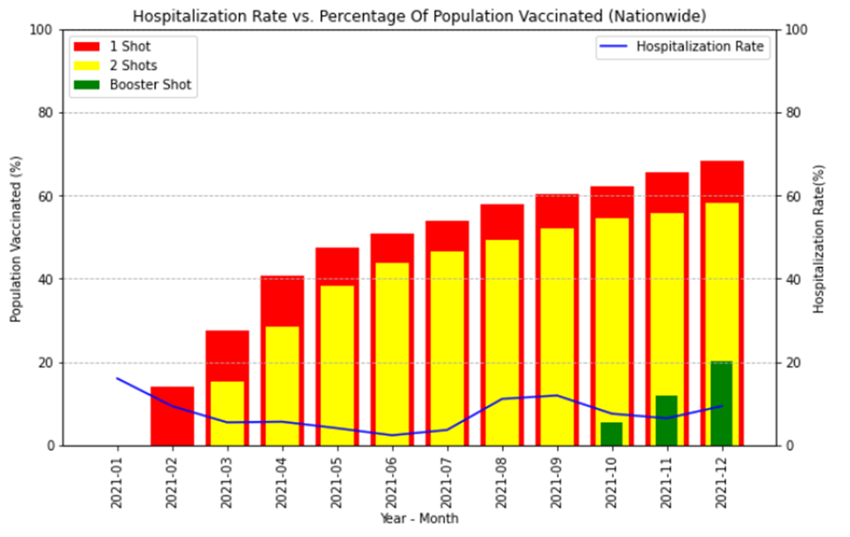

Slide 21
conclusions
United States cases and deaths:
Cumulative cases: 34,467,187
Cumulative deaths: 478,072
United States​ vaccinations:
People who received ≥1 dose:
229,098,622
People who are fully vaccinated:
195,091,307
People who received booster doses:
67,635,932
56.9% of people received ≥1 dose ​
48.5% of people are fully vaccinated
16.81% of people received booster dose​

Slide 22
THANK YOU!

